Slide 1
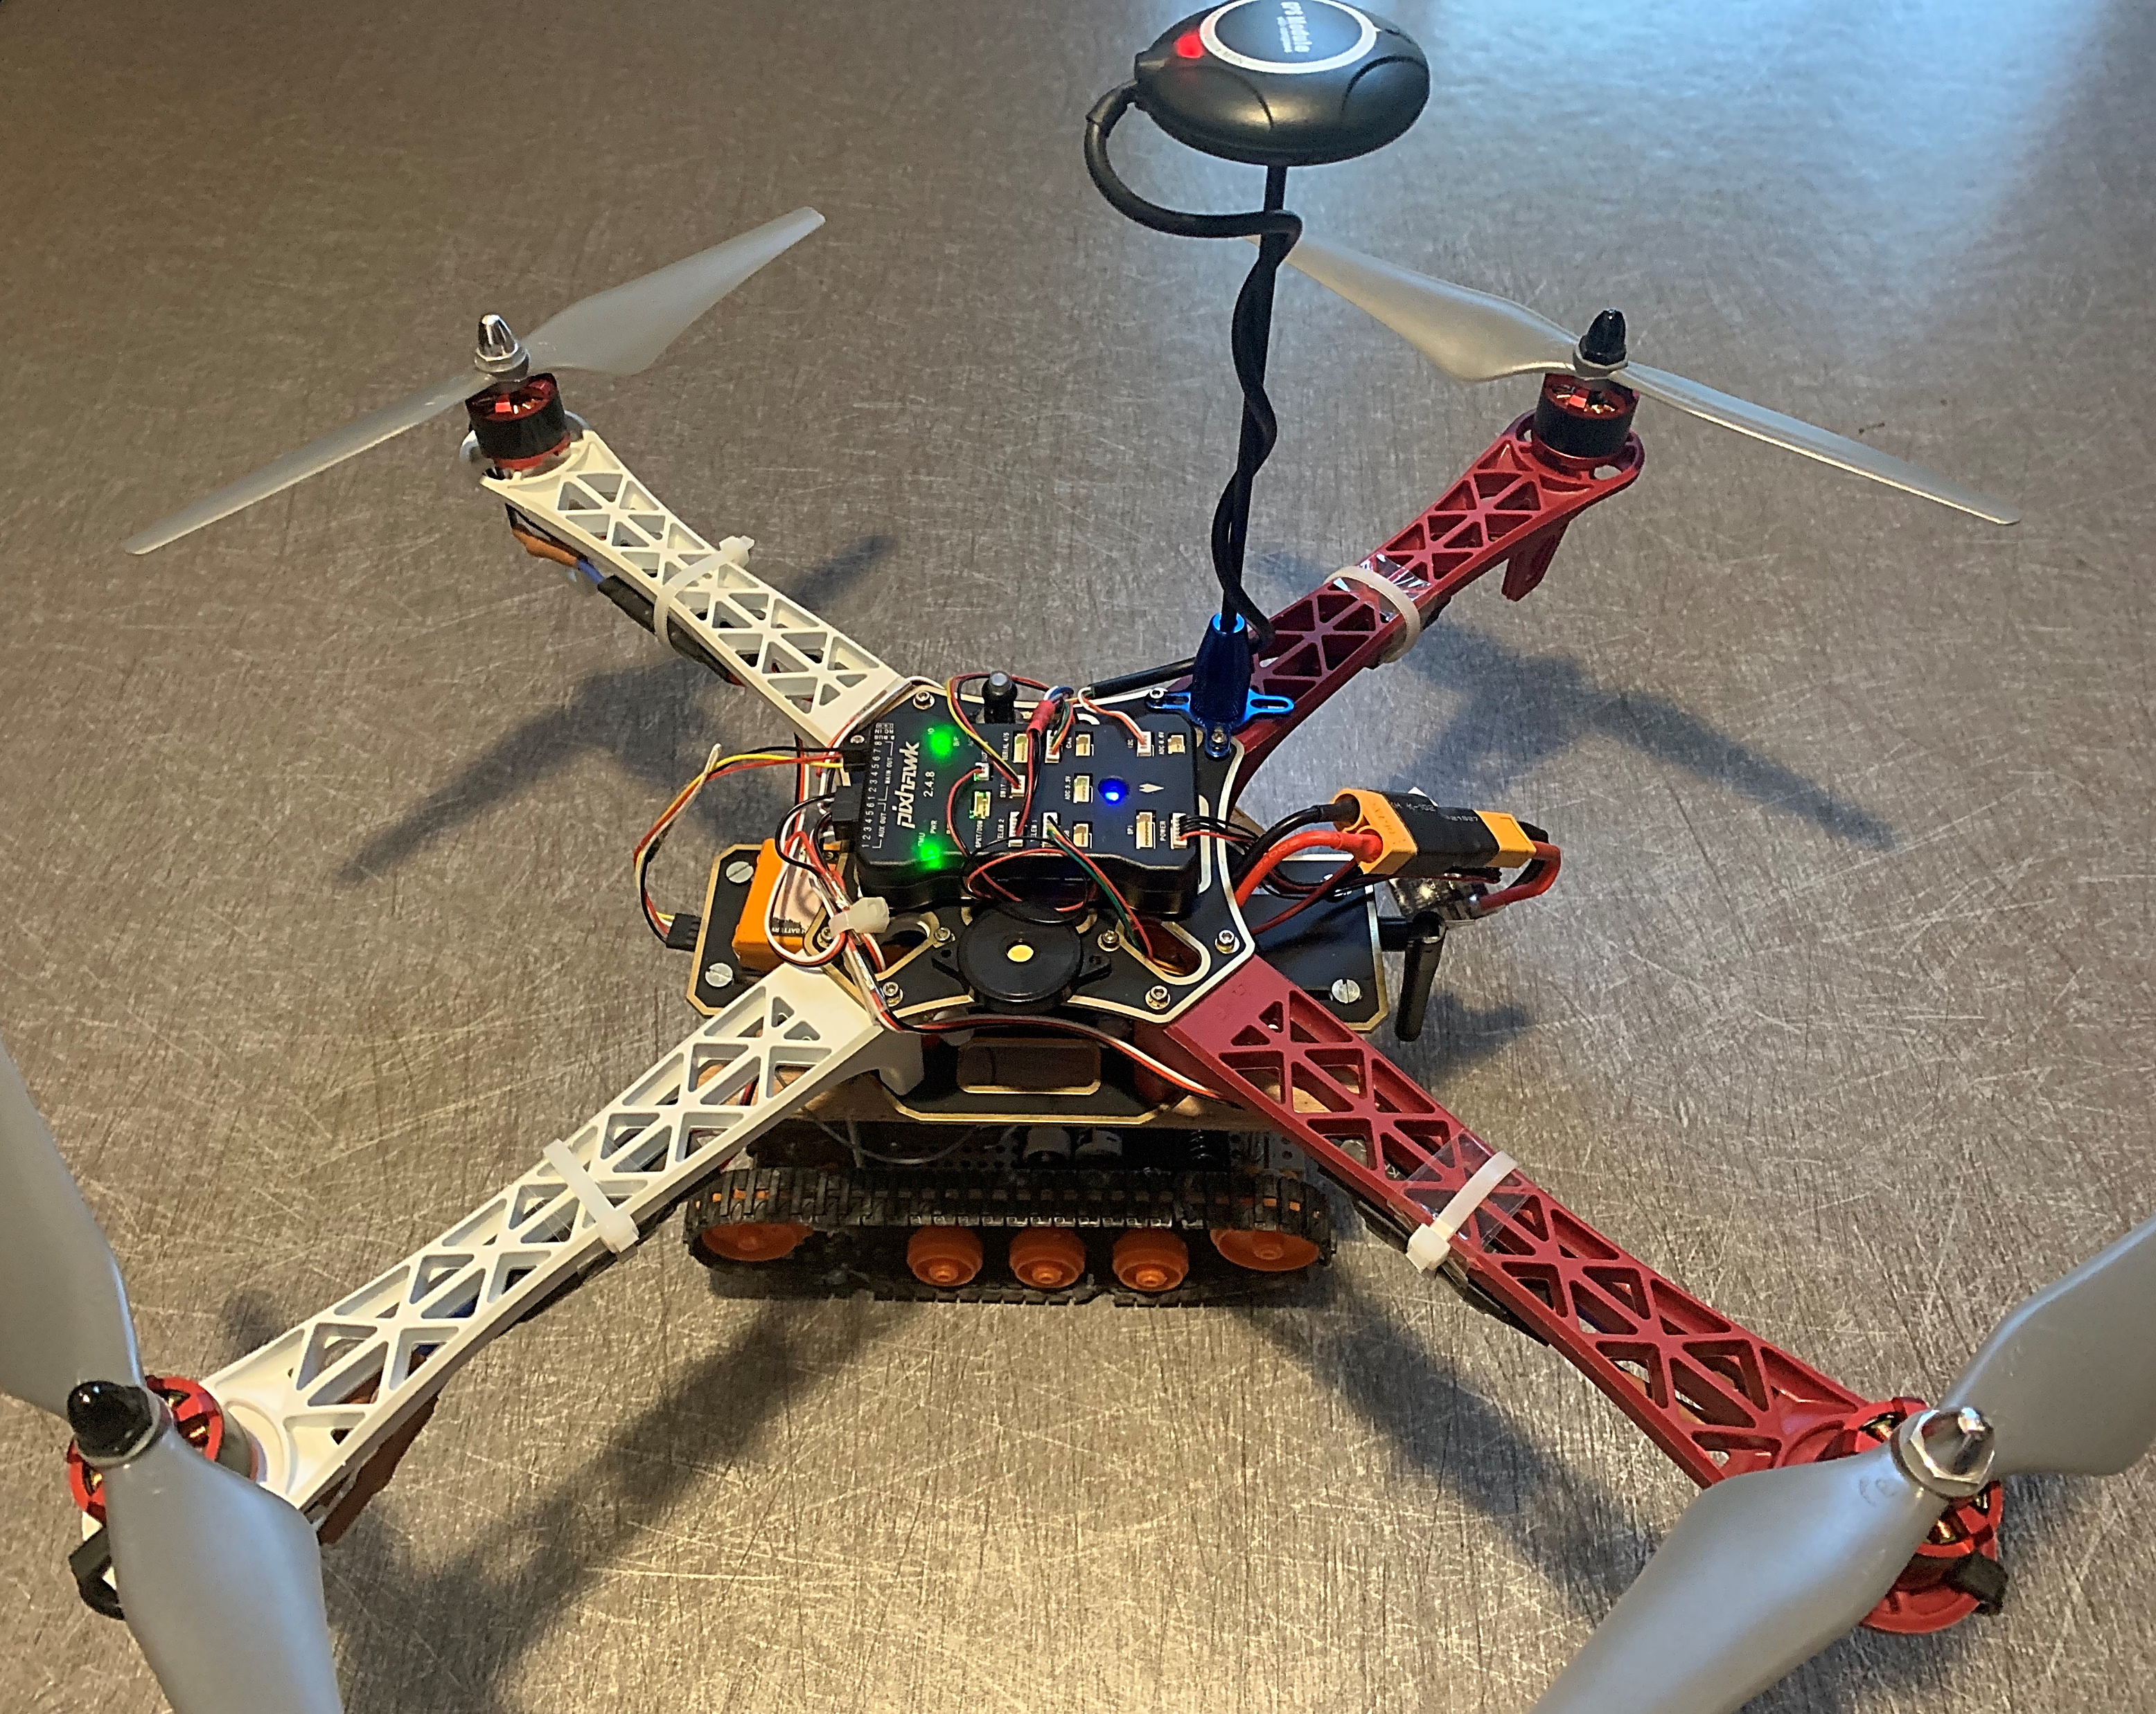




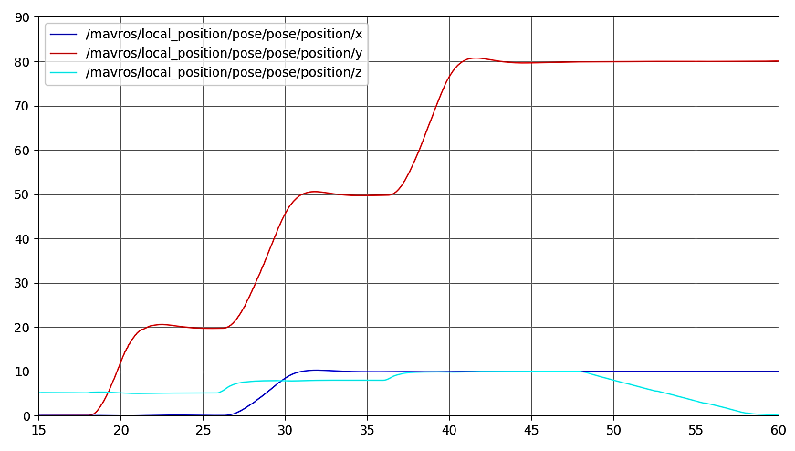
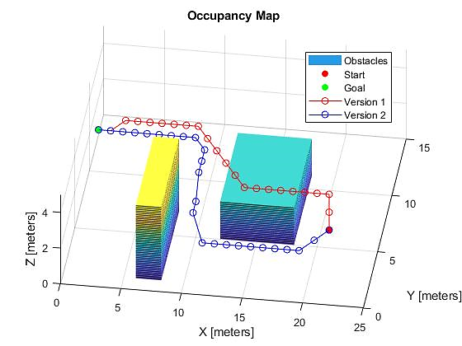
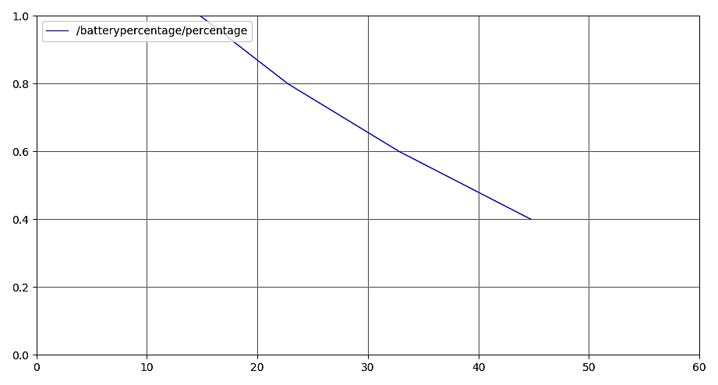

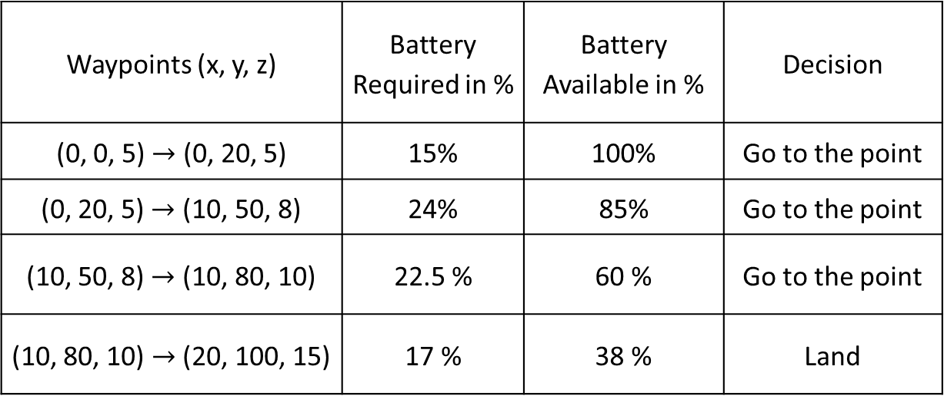
Autonomous Robotics Vehicle’s Control in Complex Environments
Ryan Xavier DSOUZA¹; Karthik MALLABADI²
Raghuvamsi DEEPTHIMAHANTHI¹; Yves BRIERE²
1: 2: ISAE-SUPAERO, Université de Toulouse, France
1. ryan-xavier.dsouza@student.isae-supaero.fr, 2. karthik.mallabadi@student.isae-supaero.fr
Context
Approach and tools
Literature Review
Research on existing path-planning algorithms.
Algorithm generation
Path-Planning Algorithm
Safe-Landing Algorithm
Testing
Developing Simulation Environment.
Studying ROS and Gazebo Simulation environments.
Validation of algorithms.
The main focus of this project is to develop an autonomous control for hybrid model of UAV and Rover.
Need of a path-planning algorithm which provides the vehicle the intelligence to reach the destination by studying its environment.
Development of safe landing algorithm which allows the vehicle to land safely in case of battery emergency or other emergencies
Results
D star algorithm for static 3D path planning has been implemented.
Two versions of the algorithm are studied by varying weights of the cost function that determines the path.
Different waypoints are tested with safe landing algorithm for the decision of the vehicle.
Waypoints (x, y, z) | Battery Required in % | Battery Available in % | Decision
(0, 0, 5) $→$ (0, 20, 5) | 15% | 100% | Go to the point
(0, 20, 5) $→$ (10, 50, 8) | 24% | 85% | Go to the point
(10, 50, 8) $→$ (10, 80, 10) | 22.5 % | 60 % | Go to the point
(10, 80, 10) $→$ (20, 100, 15) | 17 % | 38 % | Land
Next steps
Extension of the path-planning algorithm for dynamic environment.
Decision making module between air and ground module depending energy and time constraints.
Validation of algorithms in a simulated environment which resembles the real world prior to real time testing

